Slide 1
Министерство образования и науки Российской Федерации Брянский филиал федерального государственного бюджетного образовательного учреждения высшего образования «Российский экономический университет имени Г.В.Плеханова»
Составитель:
cтудентка группы М-36
Харламова Татьяна
Проверил:
преподаватель англ. яз
Молодчикова Г.И.

Slide 2
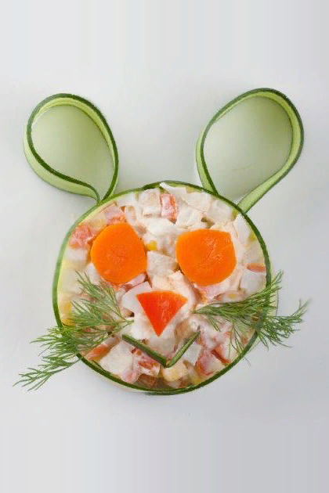
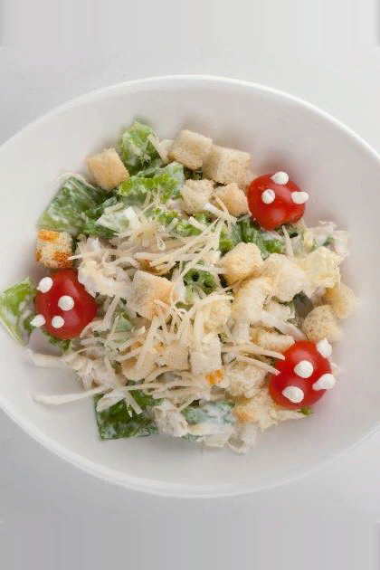
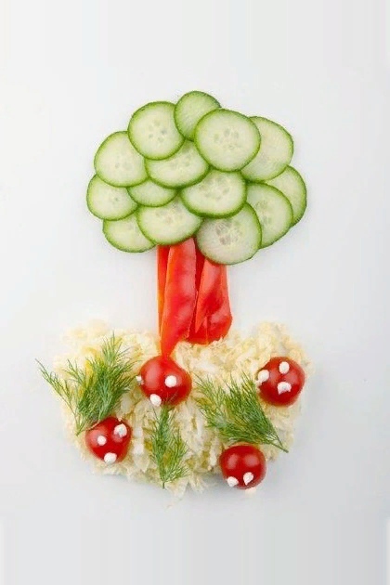
Salad with corn and Apple (a hearty salad of boiled carrots, peeled apple, eggs, canned corn, decorated with fresh cucumber and dressed with sour cream) 95rub
Caesar salad with chicken
(popular salad with chicken, cherry tomatoes, salad mix, parmesan cheese, crispy crunches and caesar sauce)
115rub
Vegetable tree
(light salad of fresh vegetables: cucumbers, bell peppers, beijing cabbage, cherry tomatoes and greens)
85rub

Slide 3
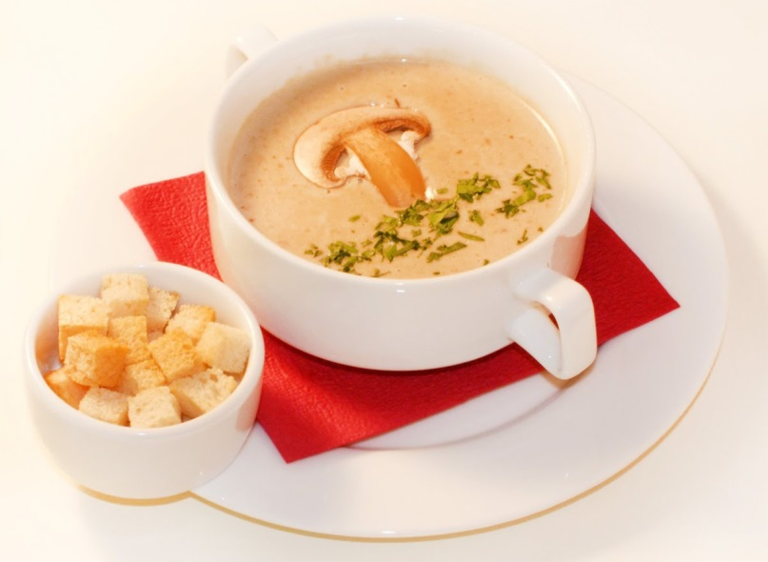
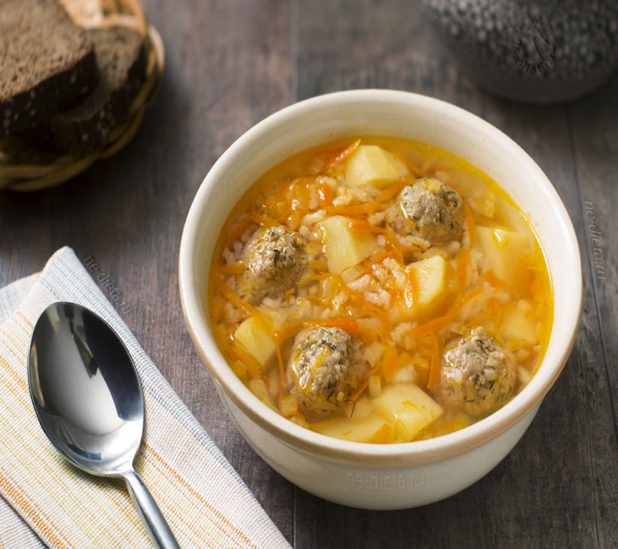
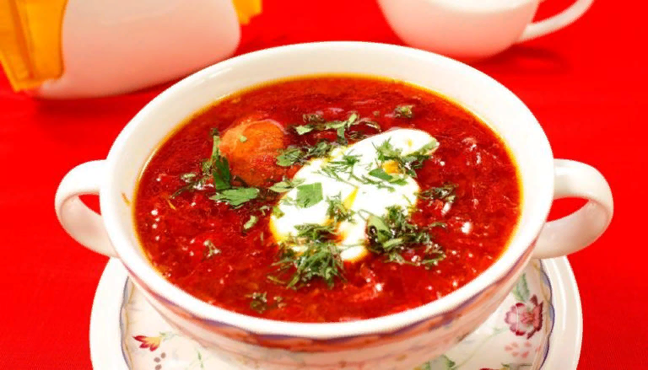
Chicken soup with meatballs 150rub
Soup-puree of mushrooms delicate mushroom soup, served with crackers
85rub
Borsch with sour cream
110rub

Slide 4
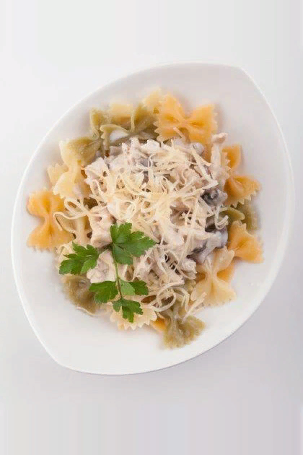
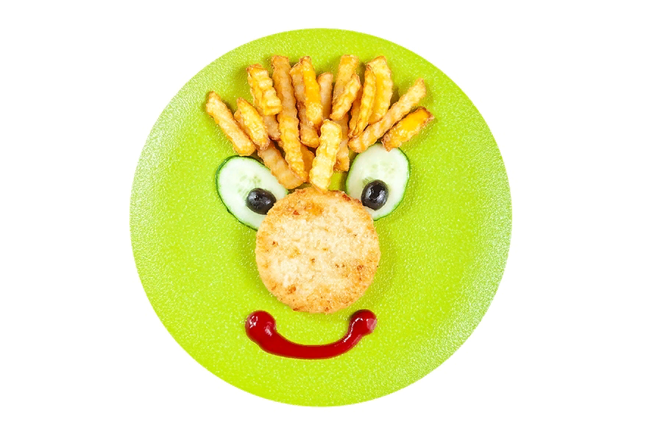
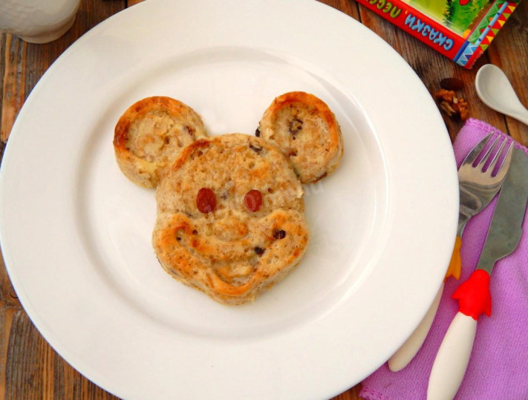
Kuzma brownie (chicken cutlet, french fries, cucumbers, ketchup) 120rub
Pasta with (chicken and mushrooms
pasta in the form of coloured bows with tender chicken and mushrooms)
120rub
Сasserole
(curd, rolled oats, egg, sugar, salt, milk,sour cream, butter, flour, raisin, walnut)
100rub

Slide 5
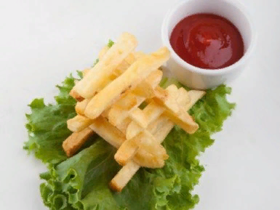
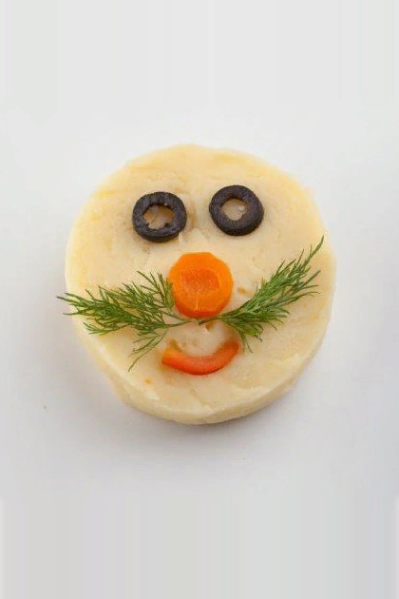
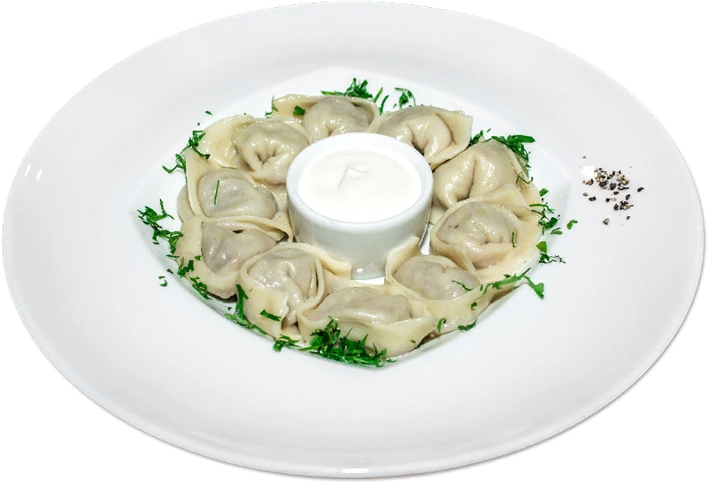
Mashed potato 120rub
Dumplings with sour cream
95rub
Potato firewood
(french fries with ketchup)
100rub

Slide 6
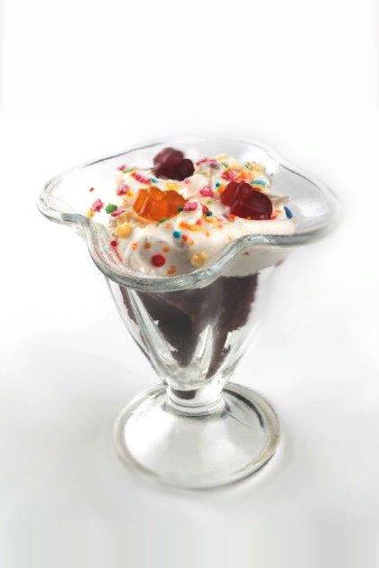
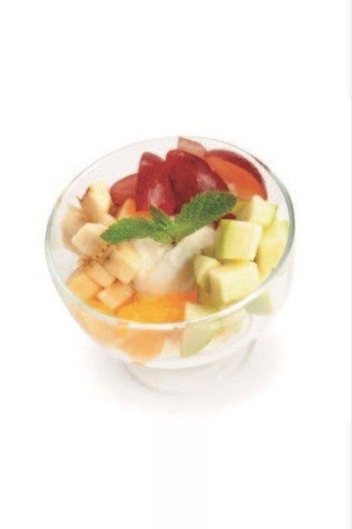
Fruit iceberg (fruit salad of grapes, green apple, banana and orange with a scoop of vanilla ice cream) 120rub
Pancake
(pancake fresh berries, honey)
80rub
Chocolate delicacy
(delicate combination of chocolate cake with sour cream. decorate with gummy bears and confetti)
100rub

Slide 7
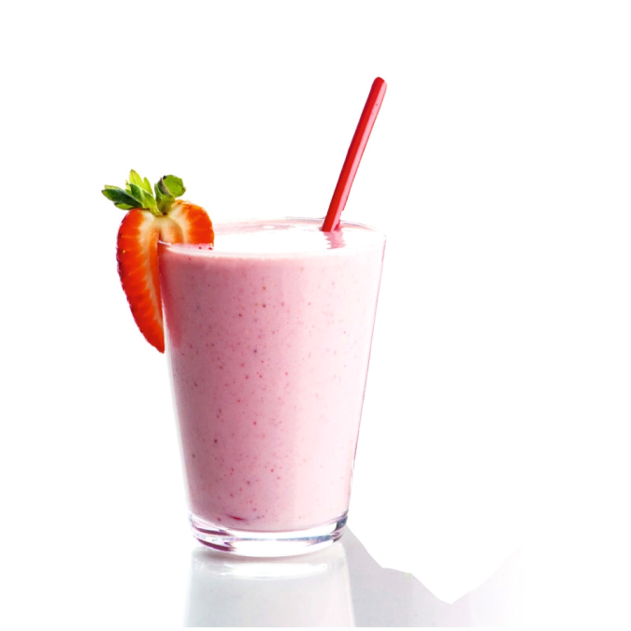
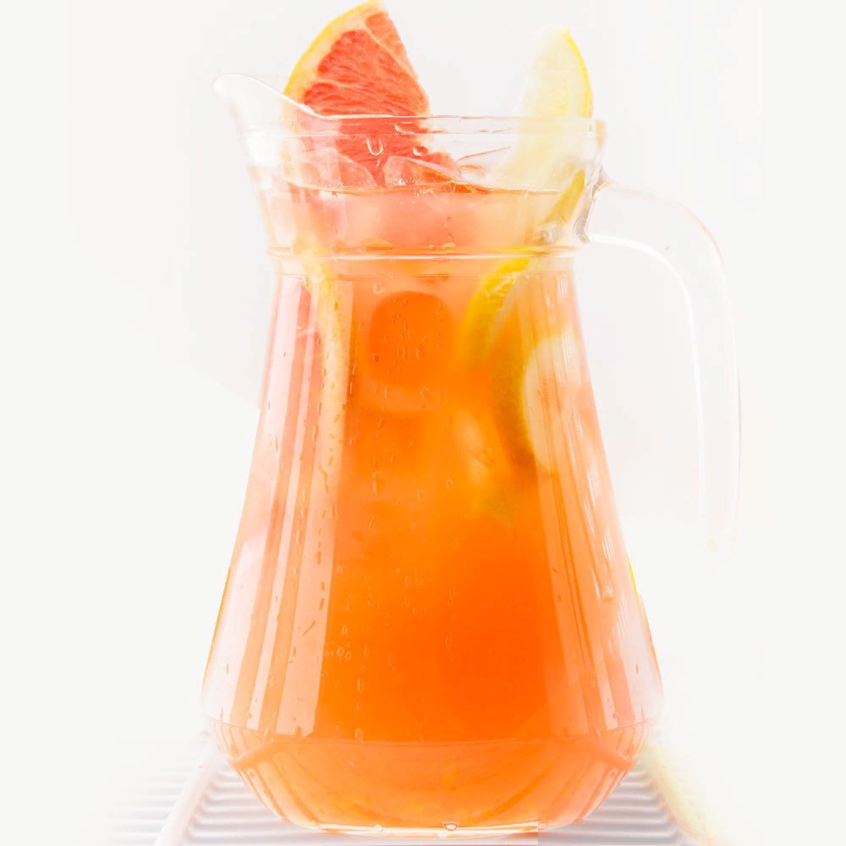
Milk shake 120rub
Assorted juice
80rub
Lemonade
40rub

